Slide 1
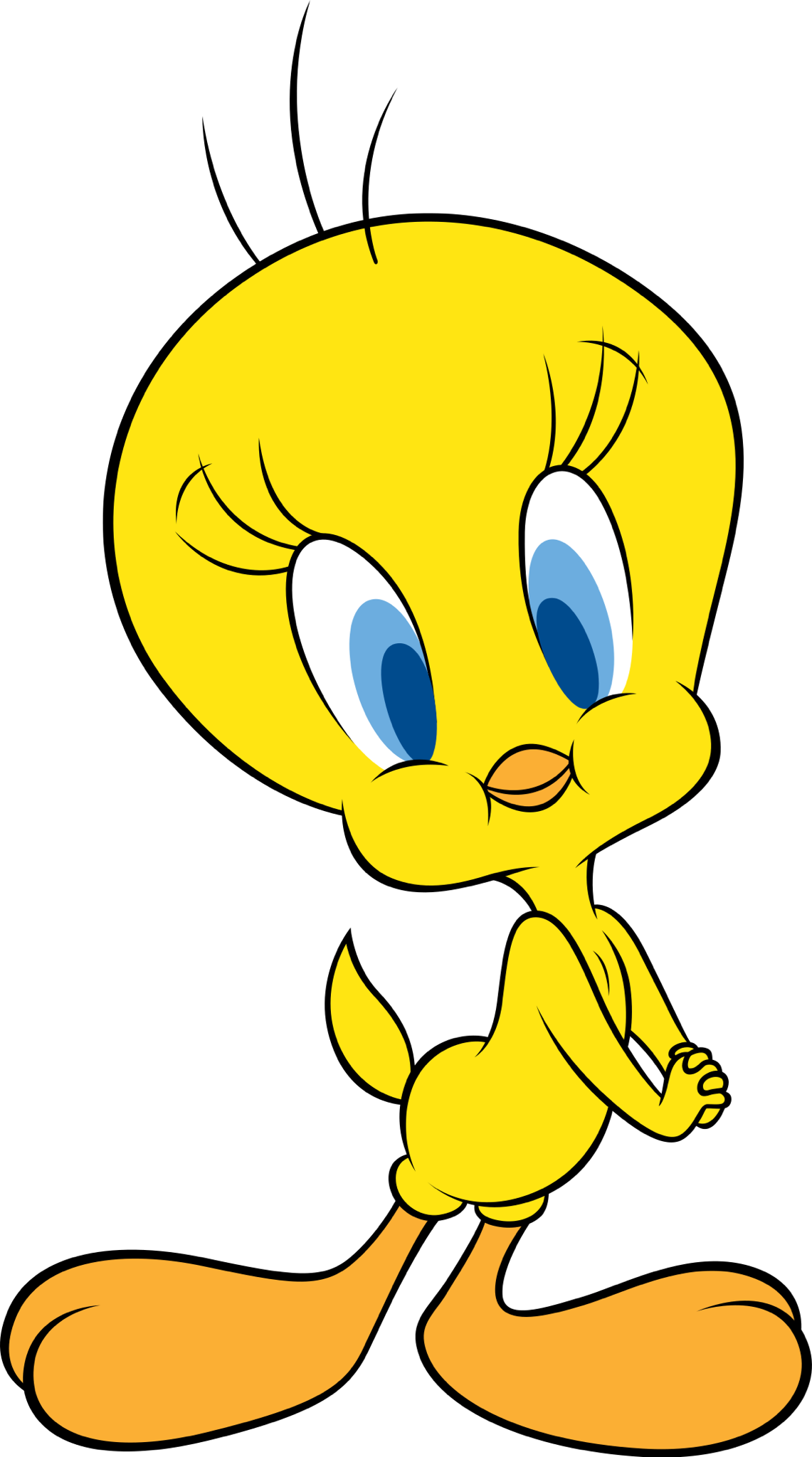

Twitter Sentiment Machine Learning Analysis
Team Tweety
Aashita Rakesh
Letha Varughese
Ryan Sabon
Francisco Zuluaga

Slide 2
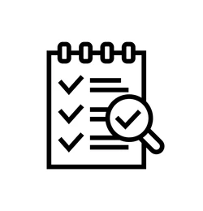
Presentation Overview
Project brief
Methodology
Machine Learning Models
Demo
Conclusion

Slide 3
Twitter Info
Twitter Background
Launched in 2006
Started with 140 character limit
In 2018 the limit doubled to 280
Tweets
Average length of 34 characters
Previously 9% were longer than 140 characters
After the new character limit it is 1%
The use of “polite” words has increased
The use of the question mark and other punctuation has increased

Slide 4

Project Brief
Goal: Use machine learning to analyze Tweets and categorize them into sad or happy sentiment
The data was pulled from Kaggle and was then cleaned
Dataset included sentiment score
0 = Positive Sentiment 1 = Negative Sentiment

Slide 5








Methodology
Data cleaning: Pandas
Model Creation: Pandas w/ scikit-learn
Tools used:
Pyspark
Python
Jupyter Notebook
Pandas
scikit-learn
Tableau
HTML, CSS, & JavaScript
Bootstrap
Flask

Slide 6
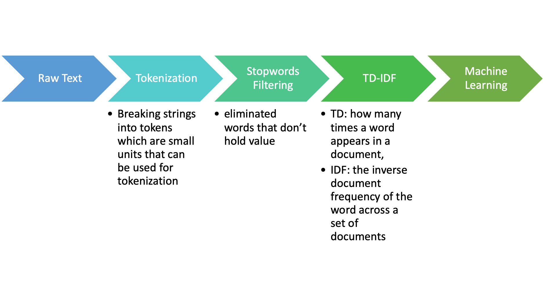
NLP Step-by-Step Process

Slide 7
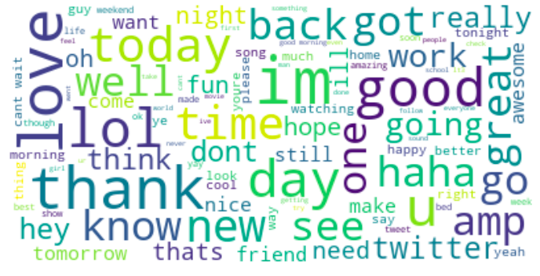
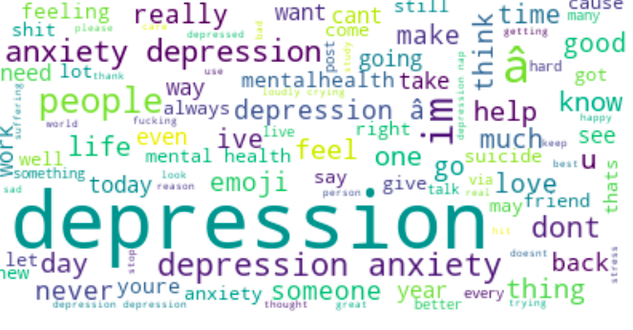
Positive/Negative Term Frequency

Slide 8
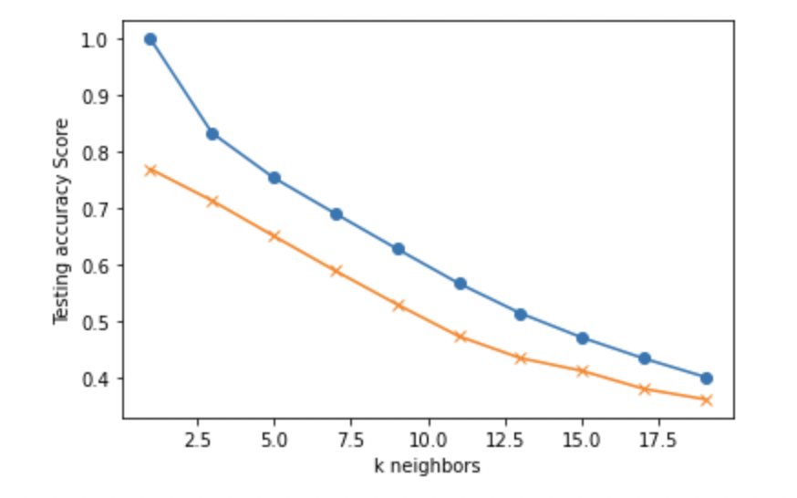
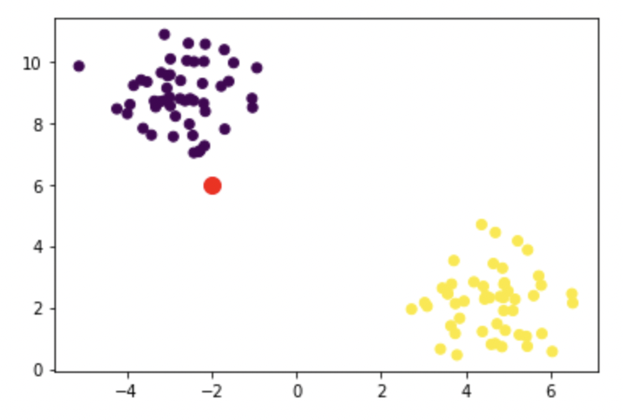
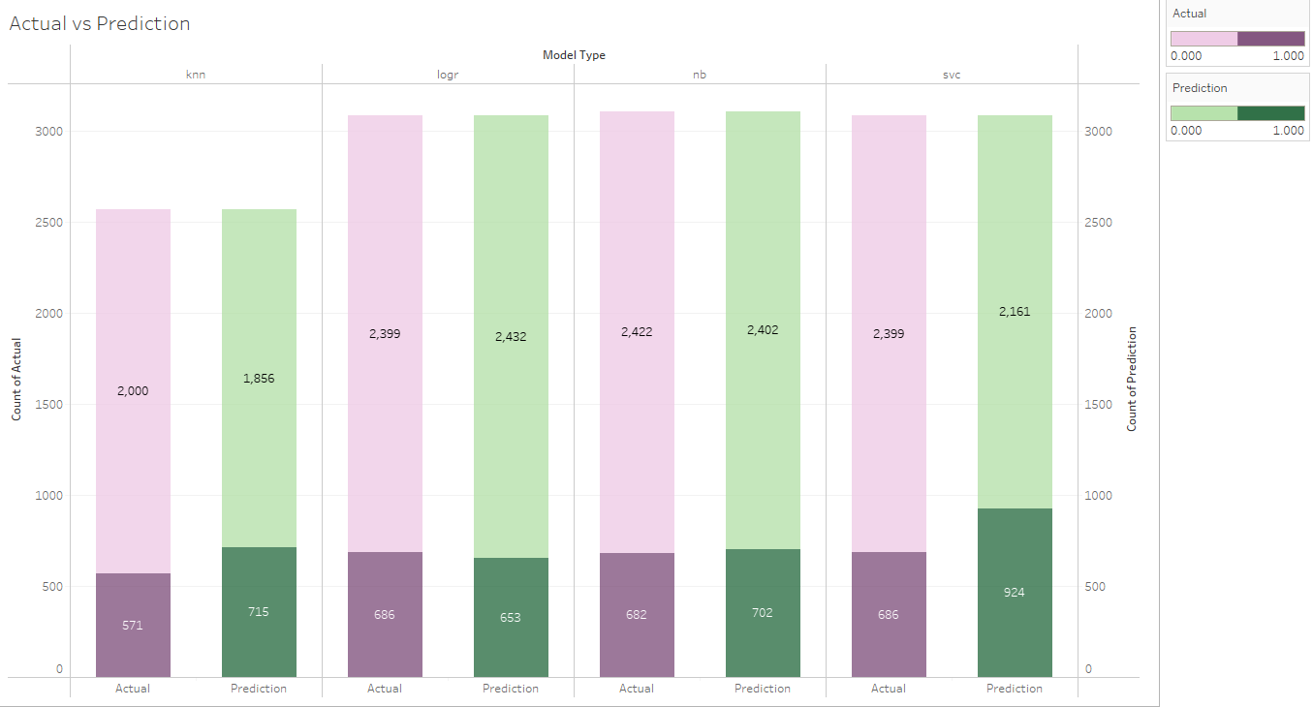
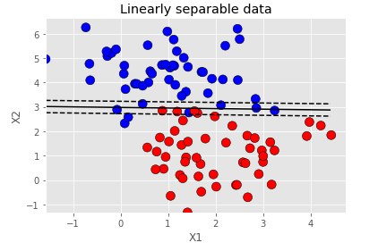
Selecting a Model
Naive Bayes
K Nearest Neighbor
Deep Learning
Logistic Regression
Decision Trees
Support Vector Machine

Slide 9
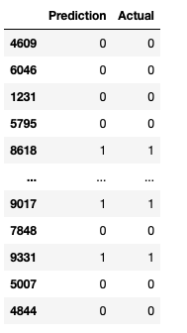
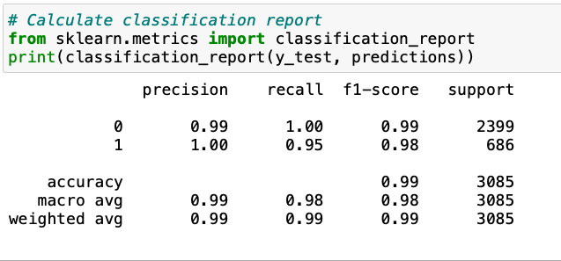
Logistic Regression

Slide 10
Logistic Regression Details
Very versatile and logic is digestible
It is very simple to train and the results are interpretable as you can easily extract the most important coefficients from the model
Used TF-IDF on top of Bag of Words to tune the model

Slide 11

Application Demonstration

Slide 12
Conclusion
Logistic regression does a good job analyzing tweets and limits the possibility of overfitting because it’s not an overly complex dataset
We can fine tune and train the other models that we used
Limitations: difficulty identifying sarcastic tweets
Possible Next Steps for further analysis: add specific events into the analysis as well as a time and location
Situation: NBA team wins
fans of the winning team could be Tweeting with positive sentiments very close after the game finishes.
Tweets will be centralized in a specific location based on the winning team (event)
Fans of the losing team could be Tweeting with negative sentiments after towards the end of the game

Slide 13
Questions?

